Slide 1
Introduction to JavaScript
Introduction to JS | Use of JS with HTML | if-else Statement
Notes:
Welcome to our lecture on Introduction to JavaScript. In this lecture we will go through the introduction to javascript, how to use JS with HTML and if else statement.

Slide 2
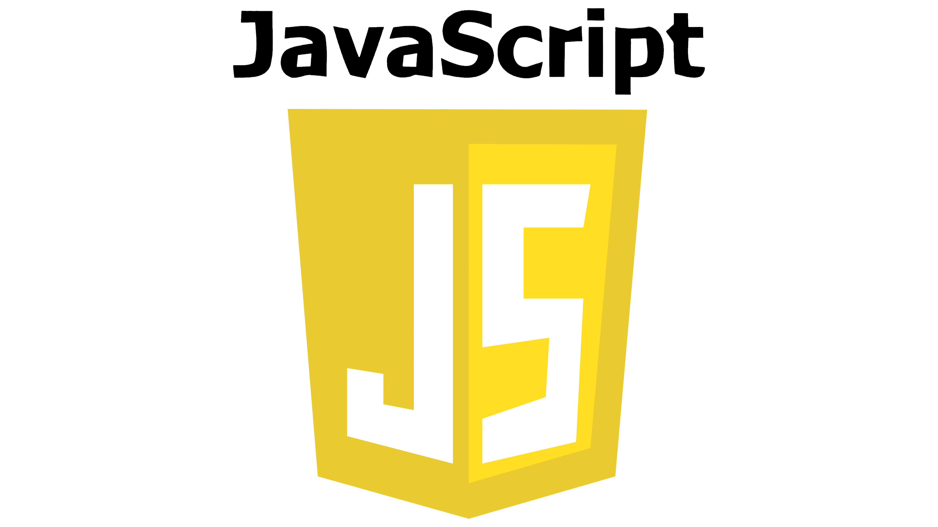
Introduction to JavaScript
JavaScript is a programming language that runs in a browser.
enabling webpages supporting actions like responding to a button click.
JavaScript code is placed in a <script> element, which can be included in the HTML file's head or body parts.
Notes:
JavaScript is a powerful programming language that runs directly in web browsers. It makes web pages interactive by enabling actions like button clicks. JavaScript code is written inside the script tag, which can be placed in either the head or body section of an HTML file. It plays a key role in creating dynamic and engaging websites for better user experiences.

Slide 3
Use of JS with HTML
JavaScript enhances HTML by adding interactive elements like buttons and forms.
It can modify HTML content dynamically using the DOM (Document Object Model).
JavaScript allows event handling, responding to user actions like clicks and inputs.
It helps control multimedia elements like audio, video, and animations within HTML.
Notes:
JavaScript works with HTML to create dynamic and interactive web pages. It enhances HTML by adding elements like buttons and forms for user interaction. JavaScript modifies content in real-time using the DOM, making web pages more responsive. It also handles events such as clicks and inputs and controls multimedia elements like audio, video, and animations for richer web experiences.

Slide 4
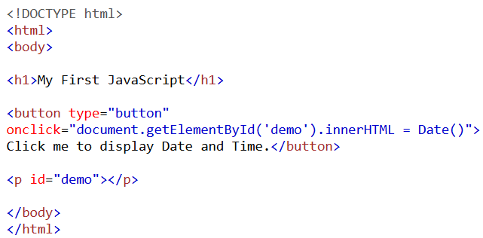
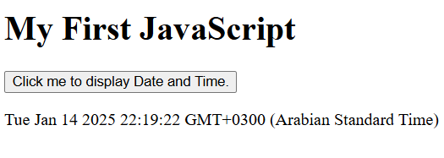
Sample JS Code
Code Output:
Notes:
This slide shows a basic JavaScript example. The HTML contains a button with an onclick attribute that runs JavaScript code when clicked. The JavaScript uses document.getElementById to target a paragraph element with the id demo and updates its content with the current date and time using the Date() function. This simple interaction displays dynamic content on the web page.

Slide 5
If-else statement
The if statement executes a block of code if a specified condition is true.
The else statement runs when the if condition is false.
else if is used to check multiple conditions in sequence.
The conditions are evaluated from top to bottom, stopping at the first true condition.
Notes:
The if-else statement in JavaScript allows decision-making in code. The if statement executes a block of code when a specified condition is true. If the condition is false, the else block runs instead. The else if statement checks multiple conditions in sequence. Conditions are evaluated from top to bottom, and execution stops when the first true condition is met.

Slide 6
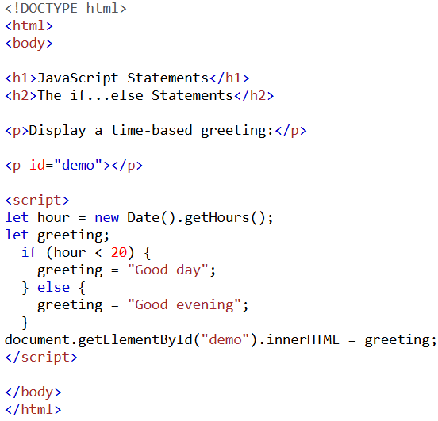
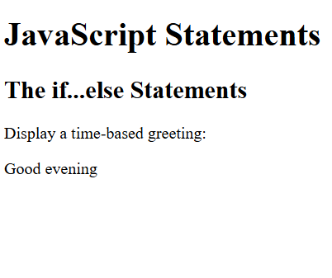
Sample Code
Code Output:
Notes:
This slide demonstrates a JavaScript if-else statement for displaying a time-based greeting. The hour variable retrieves the current hour using new Date().getHours(). If the hour is less than 20, the message Good day is shown. Otherwise, it displays Good evening. The result is output to the webpage using document.getElementById to update the content of the p element with the id demo.

